Slide 1



GRAPH
Types of Graph Terminology Storage Structure

Slide 2

Graph
A graph is a collection of nodes (or vertices, singular is vertex) and edges (or arcs)
Each node contains an element
Each edge connects two nodes together (or possibly the same node to itself) and may
contain an edge attribute
A
B
C
D
E
F
G

Slide 3

Formal definition of graph
A graph G is defined as follows:
G=(V,E)
V(G): a finite, nonempty set of vertices
E(G): a set of edges (pairs of vertices)

Slide 4

Types of graph
Directed graph (digraph)
Undirected graph (graph)

Slide 5

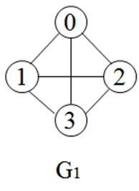
Undirected graph
An undirected graph is one in which the edges do not have a direction
‘graph’ denotes undirected graph.
G1 = ( 4, 6)
V(G1) = { 0, 1, 2 , 3 }
Undirected graph:
( v1, v2 ) in E is un-ordered.
E(G1) = { (0,1), (0,2), (0,3
(v1,v2) and (v2, v1) represent
(1,2), (1,3), (2,3) }
the same edge.

Slide 6



Directed graph
Directed graph is one in which the edges have a direction
Also called as ‘digraph’
Directed graph:
< v1, v2 > in E is ordered.
<V1,v2> and <v2, v1> represent
the two different edges.
G3 = (3, 3)
V(G3) = { 0,1,2 }
E(G3) = { <0,1> , <1,0> , <1,2>

Slide 7

Complete graph
A complete graph is a graph that has the maximum
number of edges .
for undirected graph with n vertices, the maximum number of edges is n(n-1)/2
for directed graph with n vertices, the maximum number of edges is n(n-1)

Slide 8
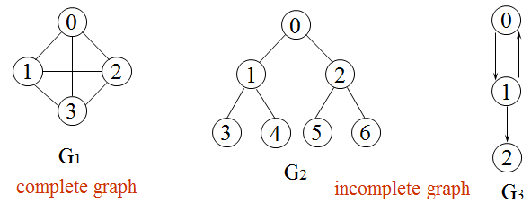
Complete graph
No.of edges = n(n-1)/2
= 4*3/2
= 12/2
= 6
No.of edges = n(n-1)/2
= 7*6/2
= 42/2
= 21
No.of edges = n(n-1
= 3*2
= 6

Slide 9

Adjacent and Incident
If (v0, v1) is an edge in an undirected graph,
v0 and v1 are adjacent
The edge (v0, v1) is incident on vertices v0 and v1
If <v0, v1> is an edge in a directed graph
v0 is adjacent to v1, and v1 is adjacent from v0
The edge <v0, v1> is incident on vertices v0 and v1

Slide 10



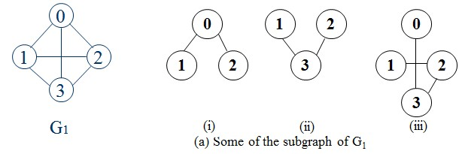
Sub- graph
A sub-graph of G is a graph G’ such that
V(G’) is a subset of V(G)
E(G’) is a subset of E(G)

Slide 11

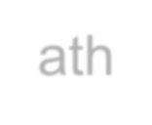
Path
A path is a list of edges such that each node is the predecessor of the next node in the list
A path from vertex vp to vertex vq in a graph G, is a sequence of vertices, vp, vi1, vi2, ..., vin, vq, such that (vp, vi1), (vi1, vi2), ..., (vin, vq) are edges in an undirected graph
The length of a path is the number of edges on it
A simple path is a path in which all vertices,
except possibly the first and the last, are distinct

Slide 12


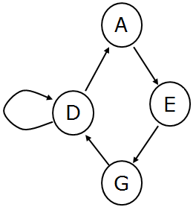
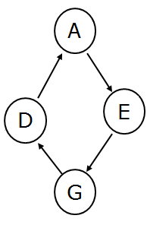
Cycle
A cycle is a path whose first and last nodes are the
same
A cyclic graph contains at least one cycle
An acyclic graph does not c ycles
ontain any c
cyclic graph
cyclic graph

Slide 13

Connected component
In an undirected graph G, two vertices, v0 and v1,
are connected if there is a path in G from v0 to v1
An undirected graph is connected if, for every pair
of distinct vertices vi, vj, there is a path from vi to vj
A connected component of an undirected graph is a
maximal connected sub-graph.

Slide 14

Strongly connected
A directed graph is strongly connected if there is a
directed path from vi to vj and also from vj to vi.
A strongly connected component is a maximal sub-
graph that is strongly connected

Slide 15


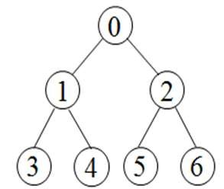
Tree
A tree is a graph that is
connected
acyclic.

Slide 16

Degree
The degree of a vertex is the number of edges incident to that vertex
For directed graph,
the in-degree of a vertex v is the number of edges that have v as the head
the out-degree of a vertex v is the number of
edges that have v as the tail
if di is the degree of a vertex i in a graph G with
n vertices and e edges, the number of edges is
e = (∑ d_{i} ) / 2
0
n−1

Slide 17


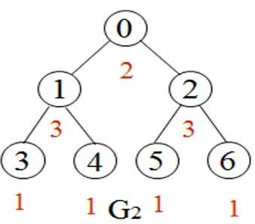
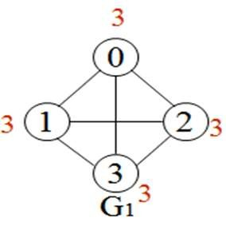
Degree - graph

Slide 18

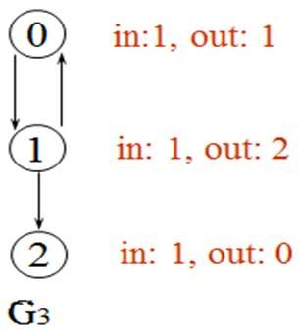
Degree - digraph

Slide 19


Graph Representation
Adjacency Matrix
Adjacency Lists

Slide 20

Adjacency matrix
Let G=(V,E) be a graph with n vertices.
The adjacency matrix of G is a two-dimensional n by n array, say adj_mat
If the edge (vi, vj) is in E(G), adj_mat[i][j]=1
If there is no edge in E(G), adj_mat[i][j]=0
The adjacency matrix for an undirected graph is symmetric
the adjacency matrix for a digraph need not be
symmetric
20

Slide 21


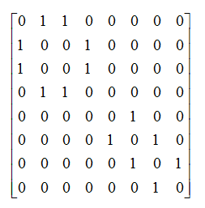

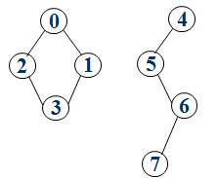
Adjacency matrix - graph
0 1 2 3
0 ⎡0 1 1 1 ⎤
⎢ 0 1 ⎥
2 ⎢1 1 0 1 ⎥
3 ⎣1 1 1 0⎦
0 1 2 3 4 5 6 7
₁ ⎢₁
₁ ⎥
⎢
⎥
0
1
2
3
4
5
6
7
21

Slide 22
Adjacency matrix - digraph
0 1 2
0 ⎡0 1 0⎤
⎢
1 1 0
0
₁ ⎥
⎢
₂ ⎢⎣0
⎥
0⎥⎦

Slide 23

Merits of Adjacency Matrix
From the adjacency matrix, to determine the connection of vertices is easy
The degree of a vertex is∑adj_ mat[i][ j]
j =0
For a digraph,
the row sum is the out_degree
the column sum is the in_degree
n−1
n−1
n−1
ind (vi) = ∑ A[ j,i]
j =0
outd (vi) = ∑ A[i, j]
j=0

Slide 24

Demerits of adjacency matrix
Storage complexity: O(|V|²)
Difficult to insert and delete nodes.

Slide 25

Adjacency list
To overcome the problem arise in the adjacency
matrix, linked list can be used
The adjacency list contains two lists
node list(vertex list)
edge list

Slide 26


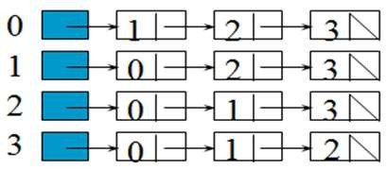
Adjacency list – graph

Slide 27
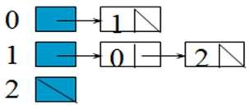
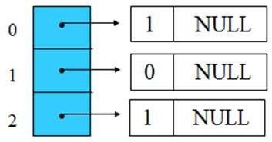
Adjacency list - digraph
Adjacency list
Inverse Adjacency list

Slide 28

Merits of adjacency list
degree of a vertex in an undirected graph
number of nodes in adjacency list
out-degree of a vertex in a directed graph
number of nodes in its adjacency list
in-degree of a vertex in a directed graph
traverse the whole data structure
Simple way to find out in-degree of vertex in a directed graph
Represent the graph in inverse adjacency list
28

